Slide 1
Android | Intermediate
Android Pattern
MVVM + Repository Pattern
Simple Implementation
Simple ECommerce
Ade Rifaldi

Slide 2
Android | Pattern
bit.ly/AndroidPattern

Slide 3


Slide 4
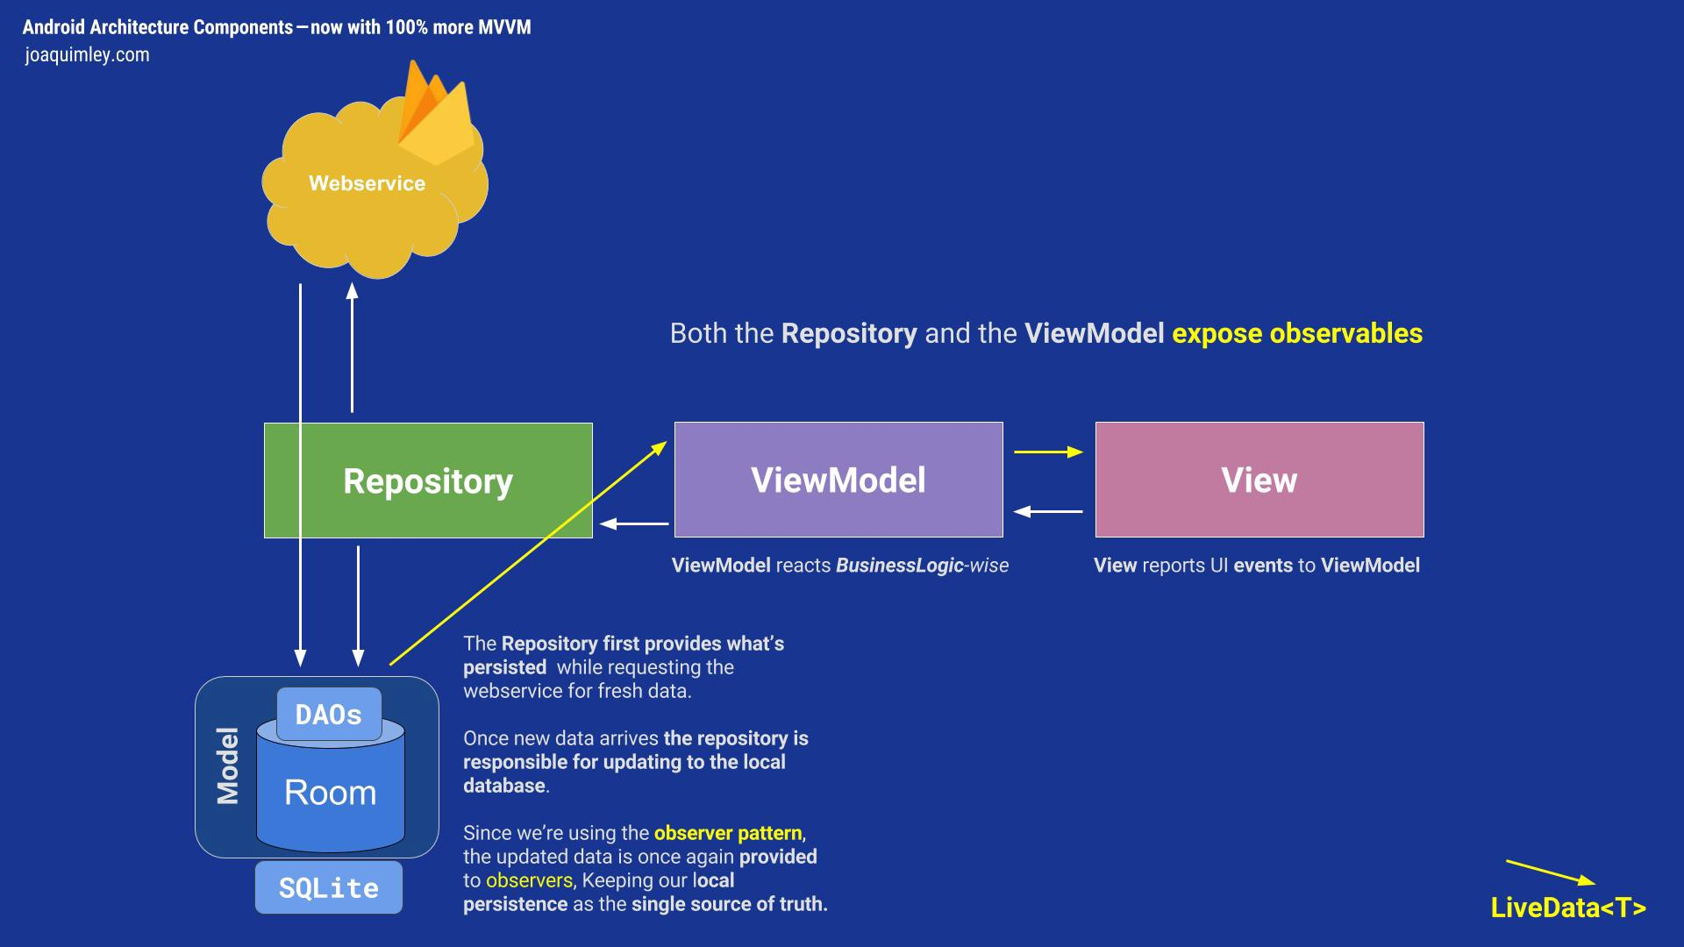

Slide 5
CodeThon | Code Marathon

Slide 6
MVVM | Simple Calculator

Slide 7
MVVM | Simple ECommerce

